Slide 1
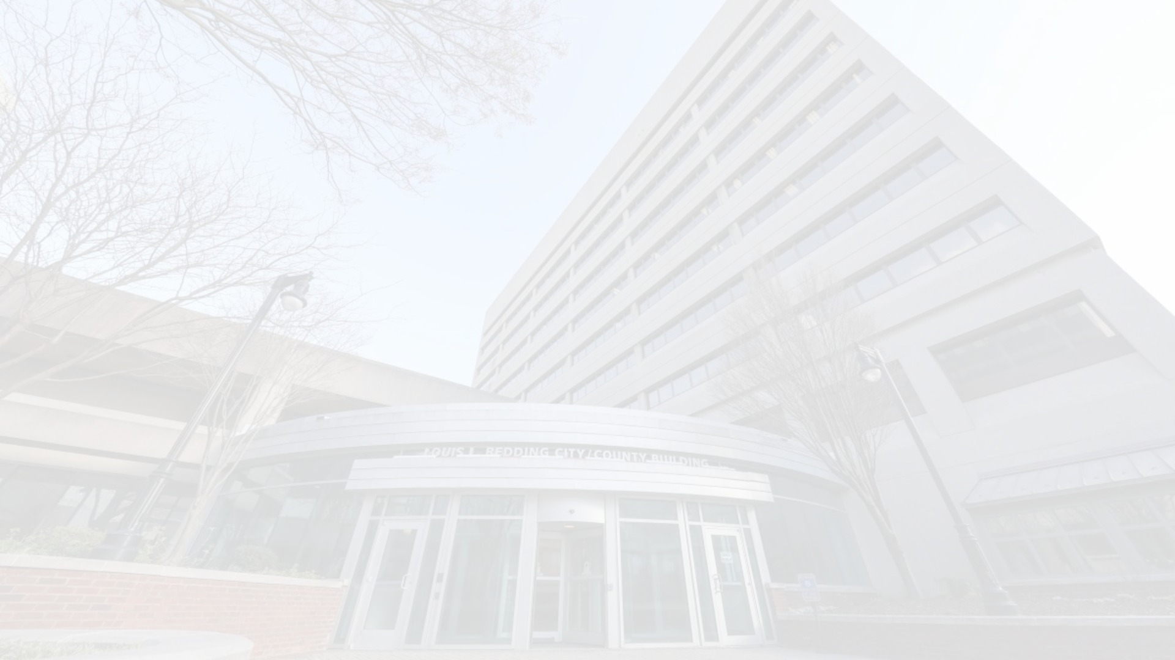
Equitable Procurement Updates - Finance and OED Committee Update 9/05/2023
Miller³ Consulting has provided recommendations to the City to improve the procurement process. In response to these recommendations, the City has been working on implementing meaningful changes that will improve access to City Procurement opportunities for minority owned businesses.

Slide 2
Council Staff Briefing
OED hosted Council analyst Kendra Brumfield-NaWangna on 6/20 to review the proposed DBE program updates.

Slide 3
B2GNow - DBE Onboarding & Management Solution
IT hosted B2GNow during their Application review meeting on 7/21. IT had the opportunity to ask questions of the B2GNow team about the application from an IT perspective. No issues or concerns were reported.

Slide 4
Increase DBE Industry Presence and Knowledge
OED recently became members of the Greater Philadelphia Chamber of Commerce. OED attended their Diverse Procurement Collaborative Reception in Philadelphia on June 8th.

Slide 5
DBE Program Rewrite
A Committee consisting of Department Heads, The Pope Consulting Group and relevant stakeholders have drafted a new Procurement Equity Program (PEP) to replace the current DBE Program.
The program write up is currently being reviewed by the Legal Department. Legal has advised their review will be completed on 9/14.
Once completed, the committee will review the legal analysis and address any recommendations.
We will look to present the new program to the Administration Board sometime early to mid October.

Slide 6
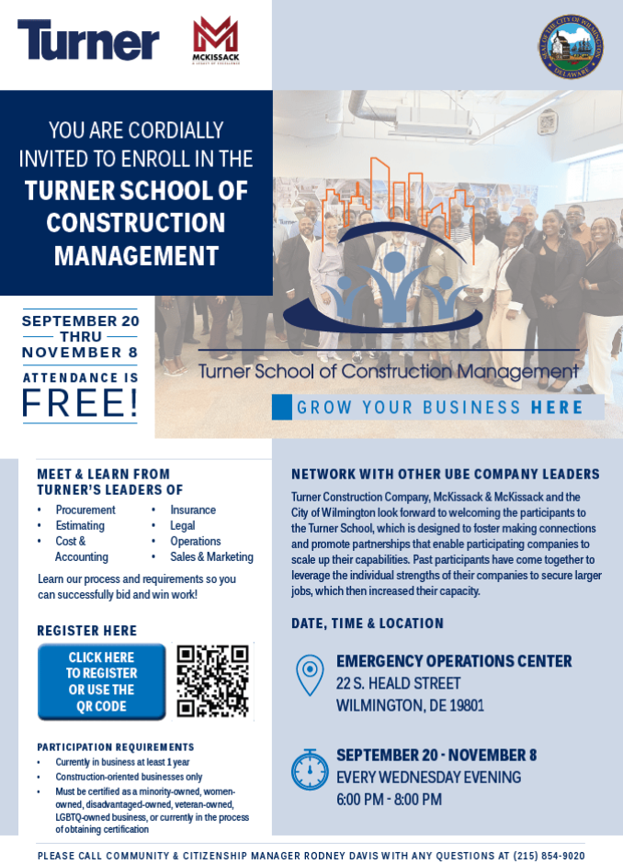
Turner School of Construction Management begins September 20!

Slide 7
DBE Analyst
A DBE Analyst position was posted on 7/24/2023. Once on board, this position will work closely with OED to ensure DBE compliance activities are conducted.

Slide 8
DBE Highlight
SME Masonry Contractors recently won their largest ever ($1.22M) contract with the City. OED played a part of their winning the bid thanks to connections made to bonding experts during recent outreach events. OED continues to explore ways we can support this business to ensure they are successful on this and future projects.

Slide 9
Appendix
A: Disparity Study Recommendations

Slide 10
# | Recommendation | Action Step | Timeline | Progress Update
1 | Change inclusion focus from programmatic (compliance with DBE regulations) to organizational (commitment to inclusive procurement environment). | Reinstate the cross functional Equal Opportunity Contract Compliance board to review complaints of inappropriate conduct towards DBEs and establish consequences for non complaince with DBE requirements. | In Process (underway, < 3 months | The City has created a working group that includes representatives from each department… Changes require buy in from all departments. When we roll out the program rewrite, we will seek a City-Wide directive for each department to actively seek opportunities to utilize DBEs for procurements.
2 | Address decentralized nature of the City’s procurement process and its effect on DBE participation. | The City is exploring procurement workflow tools and DBE support services to ensure fair, open, transparent, and inclusive decision-making throughout the City. | In Process (underway, < 3 months | OED is working to close a contract for a DBE Certifying tool.
3 | Identify community economic development and inclusive procurement objectives. | The working group is working to identify community partners willing to participate in DBE Support Services. | In Process (underway, < 3 months | Community partners have been identified and have begun providing support services
4 | Provide procurement and DBE training and development to all staff throughout the City. | The department of Finance plans to include DBE and diverse supplier content in their staff training. | In Process (underway, < 3 months | Procurement training has been completed. OED continues to look for opportunities to participate in industry trainings, workshops, and info sessions.
5 | Fully implement existing DBE programmatic initiatives and address prior internal audit concerns. | The City has analyzed the Agreed Upon Procedures (AUP) report findings and is taking appropriate actions. | In Process (underway, < 3 months | Ongoing.
6 | Conduct a culture audit which will assist the City in understanding any underlying values, perceptions, traditions, and biases. | The City will identify vendors to conduct a culture audit in the future. | Long-term (6 months or longer) | To Be Determined
7 | Address data capture issues to allow the City to effectively monitor and track all procurement decisions. | The City is exploring procurement workflow tools and DBE support services to enhance monitoring and tracking of procurement decisions. | Mid-term (3-6 months) | OED is working to close a contract for a DBE Certifying tool. The procurement team is rolling out Tyler's Vendor Self-Service, which will improve data capture quality. OED/Finance will consider pursuing a contract compliance module once a DBE admin resources is onboard.
8 | Implement procurement focused budgeting, forecasting and scheduling. | The Supplier Diversity Committee will actively search for opportunities and produce a "contracts to watch" list. | Short-term | In Process. The only source of upcoming contracts is each department's Budget presentation.
9 | Monitor contracts for the issue of concentration. | In implementing a procurement tool, the City will have data regarding prime and subcontracting participation. | Mid-term (3-6 months) | A contract compliance tool would provide data to enable analysis of contracts in order to monitor for concentration.
10 | Determine how the City can engage in youth entrepreneurship programs. | The City will work with community partners and existing youth programs to identify and support entrepreneurship opportunities. | Mid-term (3-6 months) | To Be Determined

Slide 11
# | Recommendation | Action Step | Timeline | Progress Update
11 | Refocus certification and pre-qualification efforts to identify qualified firms. | The City will identify all MBE firms in its MSA, encourage registration and certification, and collect capability information. | Mid-term (3-6 months) | A certification tool will enable OED to have a more robust certification process. We are also working to leverage existing area DBE programs as well as to align our new PE Program (PEP) with existing state program requirements.
12 | Increasing pipeline of DBEs using outreach techniques. | The City has been actively meeting with service providers and leveraging data from M³ Consulting for outreach efforts. | Mid-term (3-6 months) | OED is piloting a local DBE support program to improve outreach across the region. OED has become members of the greater Philadelphia Chamber of Commerce and has attended a Diverse Procurement Collaborative Reception on June 8 where many great connections were made, and promotion of the City happened.
13 | Expand competition by conducting a deeper dive into the City’s procurement and bidding practices. | The City will review the Capital Projects list and share vendor contracts more widely to increase competition. | In Process; Mid-term (3-6 months) | In Process. OED is reviewing budget presentations to get a sense of all upcoming projects and contracts.
14 | Promote DBE participation at the prime contractor level. | The City is working with local partners to increase MBE capacity through training and support services. | Long-term (6 months or longer) | OED is working with community partners to build capacity in support of bid ready DBEs. We have conducted our first Post Bid Analysis with a DBE providing valuable feedback to help improve their bidding on future contracts. OED has recently helped a DBE secure their largest ever ($1.22M) project with the City by making a connection to a local bonding expert.
15 | Develop DBE program which addresses requirements of large construction and development projects. | The City will review the Capital Projects list and create opportunities by unbundling according to the seven stages of development. | Mid-term (3-6 months) | In addition to identifying future opportunities, OED is working with Turner Construction to bring the Turner School of construction Management to the City in the Fall of 2023 to help build capacity within the DBE community of construction businesses.
16 | Implement small business set-asides and sheltered market projects. | The City will forecast small business purchases, encourage registration, and connect with small vendors on informal opportunities. | Long-term (6 months or longer) | As part of ongoing contract outlooks, OED will look for opportunities for set aside projects, carve outs, and sheltered markt projects. The DBE program rewrite will include set aside projects.
17 | Address concerns about slow payments. | The Finance Department will streamline the invoicing process through the Vendor Self Service module. | Long-term (6 months or longer) | Vendor self service will improve payment times. The team is considering changes to incentivize Prime Contractors to use DBEs that will improve payment terms for all involved.
18 | Develop bonding and insurance programs related to a project-based procurement process. | The City is actively searching for a partner to provide bonding support services for MBEs. | Long-term (6 months or longer) | OED has met with several bonding and insurance providers and support businesses to communicate the need for services in the City. We have established an ecosystem of bonding partners who are able to provide support and guidance on bonding. One of these new relationships has recently produced a successful DBE prime bid winner for the business' largest contract to date.
19 | Maximize use of joint ventures, mentor-protégé programs, and distributorships. | The City will leverage community partnerships and the local ecosystem to identify opportunities for joint ventures, mentorship, and distributorships. | In Process (underway, < 3 months | OED and partner organizations will work to identify opportunities for JVs, mentor-protégé relationships, etc. OED will encourage these arrangements by advocating for and supporting DBEs with the full scope of services provided to local businesses.

Slide 12
# | Recommendation | Action Step | Timeline | Progress Update
20 | Develop effective matchmaking and outreach programs. | The City will leverage community partnerships and secure a procurement management tool for enhanced outreach and matchmaking efforts. | In Process (underway, < 3 months | OED is working to close a contract for a DBE Certifying tool. This will enable Prime Bidders to more effectively engage DBEs for subcontract opportunities. OED is piloting Pro Rank Academy, which allows the City to market contract opportunities and connect interested Primes and Subs.
21 | Increase outreach by focusing efforts on expanding the total vendor and bidder pools. | The City will leverage available data sources and conduct targeted outreach and promotion of the DBE program. | Long-term (6 months or longer) | A DBE certifying tool will improve the outreach abilities of the City. We will utilize the data captured by the disparity study, OSD DBEs, DelDot DBEs, and other regional certifying bodies to promote and recruit the City's DBE program.
22 | Develop detailed and effective monitoring and tracking reports for overall projects and project-by-project. | Reporting, monitoring, and tracking will be a key requirement for any procurement management tools the City pursues. | Long-term (6 months or longer) | New reporting capabilities will be available once we have tools to capture data around contract participation. A new DBE analyst role will be responsible for reviewing projects post-award to ensure compliance with how the project was bid.
23 | Develop and assign post-award compliance responsibilities. | The City is creating a new position to conduct monitoring and compliance functions for procurements. | In Process (underway, < 3 months | A DBE contract compliance tool will enable staff to monitor adherence with DBE requirements. A new DBE analyst role will be responsible for reviewing projects post-award to ensure compliance with how the project was bid.
24 | Partner with technical assistance providers to increase the City’s ability to utilize its opportunities for capacity building. | The City is exploring its ecosystem of partners to identify those that can assist with capacity building efforts. | Long-term (6 months or longer) | Ecosystem partners have been identified who have committed to building capacity within the DBE community. (True Access Capital, The Wilmington Alliance, WEDCO, KOG International)
25 | Develop working capital loans, paymaster programs, and prompt pay requirements particularly with minority-owned banks and partners. | The City is exploring the establishment of a DBE fund at Wilmington Economic Development Corporation (WEDCO) and exploring the use of ARPA funds to support DBEs. | Long-term (6 months or longer) | The City will explore financing opportunities to help DBEs overcome capital access challenges. For now, the City's strategic fund and minority business set aside are sources for potential capital support on project specific needs.
26 | Identify Race/Gender Conscious Goal Possibilities. | The City will continue to evaluate where race and gender conscious goals are feasible and establish them accordingly. | In Process (underway, < 3 months | The team continues to evaluate program changes and will implement race and gender conscious policies where feasible and justifiable using the Disparity Study findings.

