Slide 1
Regulation and Guidance for the American Rescue Plan Act
Presentation for the City of Wilmington’s
Finance & Economic Development Committee
May 25, 2021

Slide 2

Amount of funding
Wilmington is entitled to receive $55,345,780.00
The funds will come to the City in two tranches, directly from the U.S. Treasury to the City of Wilmington, because the City has a population greater than 50,000
The first payment is expected to arrive in the next two weeks, and will be approximately $27 million.
The balance will arrive approximately 12 months later.

Slide 3
Use of funds as determined by ARPA
To respond to the public health emergency or its negative economic impacts, including assistance to households, small businesses, and nonprofits, or aid to impacted industries such as tourism, travel, and hospitality
To respond to workers performing essential work during the COVID-19 public health emergency by providing premium pay to eligible workers;
For the provision of government services to the extent of the reduction in revenue due to the COVID–19 public health emergency relative to revenues collected in the most recent full fiscal year prior to the emergency;
To make necessary investments in water, sewer, or broadband infrastructure.

Slide 4
The First Category:
To respond to the public health emergency or its negative economic impacts, including assistance to households, small businesses, and nonprofits, or aid to impacted industries such as tourism, travel, and hospitality;
Eligible uses for the Public Health Emergency
Covid-19 mitigation and prevention (contact tracing, testing, ventilation improvement, capital investments in public facilities to meet pandemic operational needs)
Medical expenses, including costs for medical services for individuals with “long Covid”
Meeting behavioral health care needs including addiction treatment, due to a national spike in overdose deaths
Addressing disparities in public health outcomes, and economic outcomes in our communities
Generally as broad as the CARES Act

Slide 5
The First Category (cont.):
To respond to the public health emergency or its negative economic impacts, including assistance to households, small businesses, and nonprofits, or aid to impacted industries such as tourism, travel, and hospitality
Eligible use for the Economic Recovery
Assistance to unemployed workers such as job training
Deposits into the State unemployment insurance trust fund
Loans or grants to small businesses and non-profits to mitigate financial hardship such as declines in revenues, or to support the cost of rent, mortgage, payroll and benefits
Aid to impacted industries such as tourism, travel and hospitality
Assistance to households such as: utility assistance, counseling and legal aid to prevent homelessness, food assistance, rent, mortgage, home repairs, emergency assistance for burials, weatherization, internet access
  There is a 4-step analysis to determine the eligibility of assistance to households, unless the household is located in a Qualified Census Track. More on the next slide

Slide 6

The First Category (cont.):
Presumption of eligibility within
Qualified Census Tracks
What is a Qualified Census Track (QCT)?
  Geographic locations with a large proportion of low income residents
  Wilmington has 13 QCT
ARPA presumes that certain types of services, when provided within Qualified Census Tracks, are eligible uses of ARPA funds:
  Affordable housing development to increase the supply of affordable and high-quality living units
  Services to address homelessness, such as improving access to stable, affordable housing among unhoused individuals
  Housing vouchers, residential counseling, housing navigation assistance
  Enhanced learning services, including pre-kindergarten
  High quality childcare

Slide 7
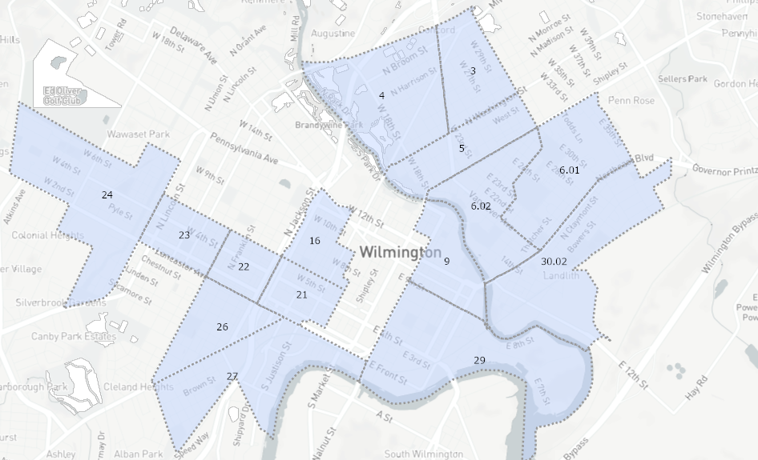
Wilmington’s QCTs
3 | Baynard Boulevard
4 | Baynard Boulevard
5 | North Market
26 | Browntown/Hedgeville
27 | Browntown/Hedgeville
9 | Eastside
29 | Eastside
6.01 | Price's Run
6.02 | Price's Run
30.02 | Riverside
24 | Southwest Wilmington
16 | West Center Ctiy
21 | West Center Ctiy
22 | West Side
23 | West Side

Slide 8

The First Category (cont.):
Economic assistance
If economic assistance is provided outside of a QCT, then a 4-step analysis must be conducted:
Identify the harmful effect of COVID-19 the activity will address.
Assess the causal or compounding connection.
Assess for disproportionate impact on distressed sectors or populations.
Determine how to prove the expense produces the expected outcome. Economic
As a higher degree of proof is required for this 4-step analysis we also need to provide supporting documentation

Slide 9
The Second Category
To respond to workers performing essential work during the COVID-19 public health emergency by providing premium pay or grants to eligible workers
Essential workers – “those workers needed to maintain continuity or operations of essential critical infrastructure”
Essential work – work requiring the physical presence at a jobsite
Amount
up to $13 per hour, above the salary
Maximum ARPA premium payment cannot exceed $25,000 per eligible worker
compensation prioritized for lower income eligible workers who performed essential work
Categories of essential workers:
  Healthcare workers
  Public health and safety
  childcare
  Education
  Sanitation
  Transportation
  Food production service
Payments in this category have enhanced reporting requirements.

Slide 10
The Third Category
For the provision of government services to the extent of the reduction in revenue due to the COVID–19 public health emergency relative to revenues collected in the most recent full fiscal year prior to the emergency
Revenue replacement
For the purposes of the revenue replacement category, we are looking only at General Revenue
  Excludes: refunds, proceeds from issuance of debt or sale of investments, utility income
The US Treasury’s formula places a predetermined 4.1% annual growth rate into their formula
General calculation steps:
Identify the revenue collected in the most recent full fiscal year prior to the pandemic. This is the base year.
Estimate the growth rate the city would have experienced using either 4.1% or the average annual revenue growth in the three full fiscal years prior to the public health emergency, whichever is higher.
Identify actual revenue collected over the past 12 months.
lost revenue is equal to the expected growth rate less actuals.

Slide 11
The Fourth Category
To make necessary investments in water, sewer, or broadband infrastructure.
Water infrastructure projects – must be aligned with types or categories of projects eligible for financial assistance through the EPA’s Clean Water State Revolving Fund, or the Drinking Water State Revolving Fund
  Improve drinking water infrastructure
  Support consolidation or establishment of drinking water systems
Sewer projects – may include construction of publically owned treatment infrastructure, including infrastructure which manages and treats stormwater or subsurface drainage water, facilitate water reuse
Cybersecurity spending – ARPA funds can be used for investment in cybersecurity needs to protect water or sewer infrastructure

Slide 12

The Fourth Category (cont.)
To make necessary investments in water, sewer, or broadband infrastructure.
Broadband – projects must "be designed to provide service...to unserved and underserved households and businesses."
Unserved and underserved households or businesses means one or more households or businesses that are not currently served by a wireline connection that reliably delivers at least 25 Mbps download speed and 3 Mbps of upload speed.
Eligible broadband projects must reliably meet or exceed symmetrical 100 Mbps download speed and upload speeds;
If that is impossible, then the projects must reliably meet or exceed 100 Mbps download and between at least 20 Mbps and 100 Mbps upload speeds and be scalable to a minimum of 100 Mbps symmetrical for download and upload speeds

Slide 13
Ineligible uses for ARPA funds
ARPA funds cannot be used for:
Contributions to rain-day funds, financial reserves, or similar funds
Tax cuts
Any payment of interest or principal on outstanding debt instruments
Fees or issuance costs for new debt
A settlement, judgment, consent decree or judicially confirmed debt

Slide 14

ARPA imposes reporting requirements on all jurisdictions receiving funds
One interim report
  To include recipient's expenditures by category from the date of the award to July 31, 2021
  Report must be submitted by August 31, 2021
Quarterly reports through the end of the award period which is December 31, 2026
  To include financial data, information on contracts and subawards over $50,000, types of projects funded
  The first quarterly report is for the time period from award of funds to September 30, 2021, and must be submitted by October 31, 2021

